Slide 1
Microsoft PowerBI Project
Project 1 – Crime Analysis Report
Submitted by
RABIA BASRI

Slide 2
Dashboard Tasks
1. Total Crimes:
- Sum of all reported crimes in the dataset.
2. Crime Distribution by Year and Yearly Changes:
- Analysis of crimes categorized by year, including insights into the year-over-year changes.
3. Crimes by Time Range (e.g., 3:00 AM to 5:59 AM):
- Exploration of crime occurrences within specific time intervals, providing a detailed breakdown.
4. Hitmap Showing Crime Distribution by Weekdays and Months:
- Visualization using a hitmap to illustrate how crimes are distributed across weekdays and months.
5. Crimes by Country:
- Examination of crimes categorized by the country where they occurred.

Slide 3
Dashboard Tasks
6. Total Resolved and Unresolved Crimes:
- Distinction between resolved and unresolved crimes, offering an overview of the overall resolution rate.
7. Monthly Crime Trend with Percentage Variance:
- Analysis of the monthly crime trend, accompanied by the percentage variance to highlight fluctuations.
8. Identification of the Most Dangerous Time of the Day:
- Exploration to pinpoint the specific time periods during the day associated with a higher frequency of crimes.

Slide 4
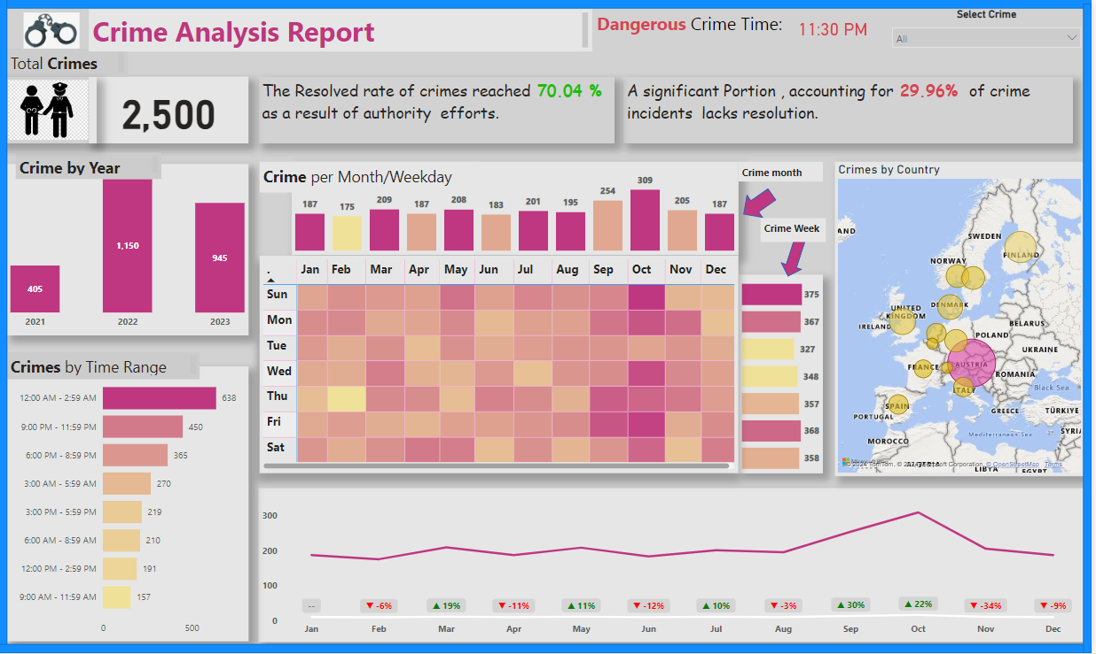

Slide 5
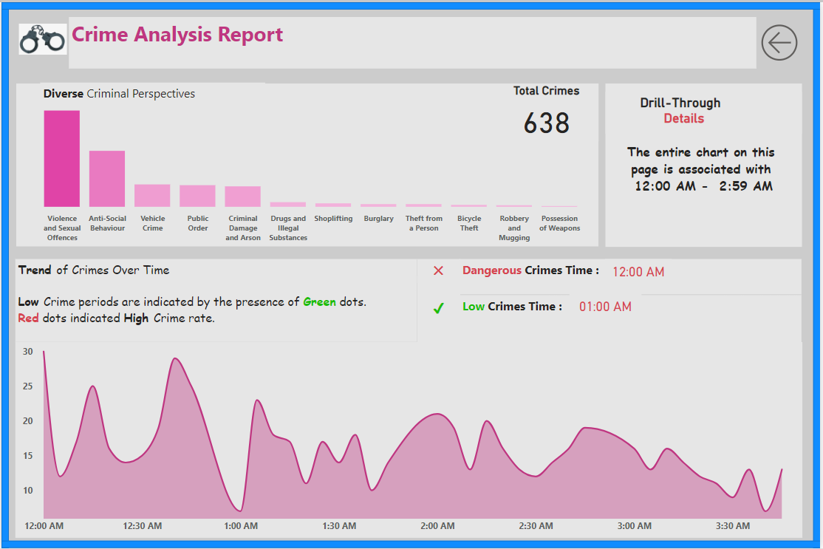

Slide 6
Thank You.

Slide 7
Microsoft PowerBI Project
Project 2 – HR Analytics Dashboard
Submitted by
RABIA BASRI

Slide 8
Dashboard Tasks
1. Total Employees:
- Sum of all the Employees in the dataset.
2. Finding the Total Attrition and Attrition Percentage:
- Analysis Attrition of the Employees , the sum and the percentage of the attrition.
3. Average years spent in the company by all the employees:
- Exploration of the employees interest in their job and the Time they had spent in the Company.
4. Filter to distribute the data by Sex(Male or Female):
- Visualization Changes to the filters used in Dashboard according to the sex.
5. Count of Employees working in Different Departments:
- Table visual to show the count of employees in different departments.

Slide 9
Dashboard Tasks
7. Attrition of the employees with time:
- An Area chart to display how the employees interest with Time.
8. Finding the Attrition rate Salary Hike and Business Travel:
- Analyzing Attrition of the Employees , the sum and the percentage of the attrition.
9. Find how the Employees Education and Job role is effecting the Attrition rate:
- Exploration of the employees Job Role and their Education.
10. A Reset Button to Reset all the Filters:
- Visualization Changes to the Default view once the Reset Button is clicked.

Slide 10
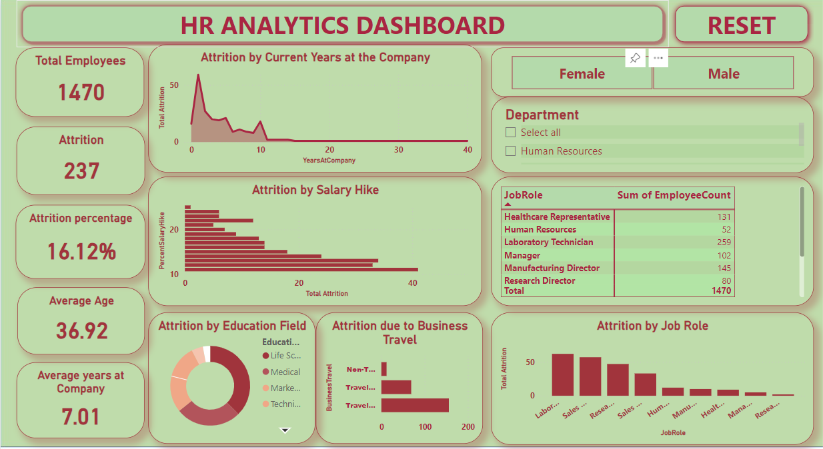

Slide 11
Thank You.

Slide 12
Microsoft PowerBI Project
Project 3 –Dashboard
Submitted by
RABIA BASRI

Slide 13
Dashboard Tasks
Book Ranking Analysis: Investigate the distribution of book rankings among the top 100 Bestselling books on Amazon. Identify trends or patterns in book rankings over time.
Price and Rating Correlation: Explore the relationship between book prices and ratings. Determine if there's a correlation between the price of a book and its overall rating.
Author Performance Analysis: Analyze the performance of authors based on the number of books they have in the top 100 Bestselling list. Identify top-performing authors and their genres.
Genre Popularity Trends: Examine the popularity of different genres over the years. Determine which genres have been consistently popular and which ones have gained or lost popularity.
Review Sentiment Analysis: Conduct sentiment analysis on book reviews to understand the overall sentiment towards bestselling books. Identify trends in positive and negative reviews across different genres.
Reviewer Rating Comparison: Compare the ratings given by reviewers with the overall ratings of the books. Determine if there's a discrepancy between reviewer ratings and the book's overall rating.

Slide 14
Dashboard Tasks
Verified vs. Non-verified Reviews: Compare the ratings and sentiments of verified and non-verified reviews. Determine if there's a difference in the credibility or trustworthiness of these reviews.
Temporal Analysis of Reviews: Analyze the distribution of reviews over time. Identify peak periods of review activity and correlate them with events like book launches or promotions.
Top Authors and Genres by Rating: Identify the top authors and genres based on average ratings of their books. Determine which authors and genres are highly rated by customers.
Review Length and Rating Correlation: Investigate if there's a correlation between the length of reviews and the ratings given. Determine if longer reviews tend to be more positive or negative.

Slide 15
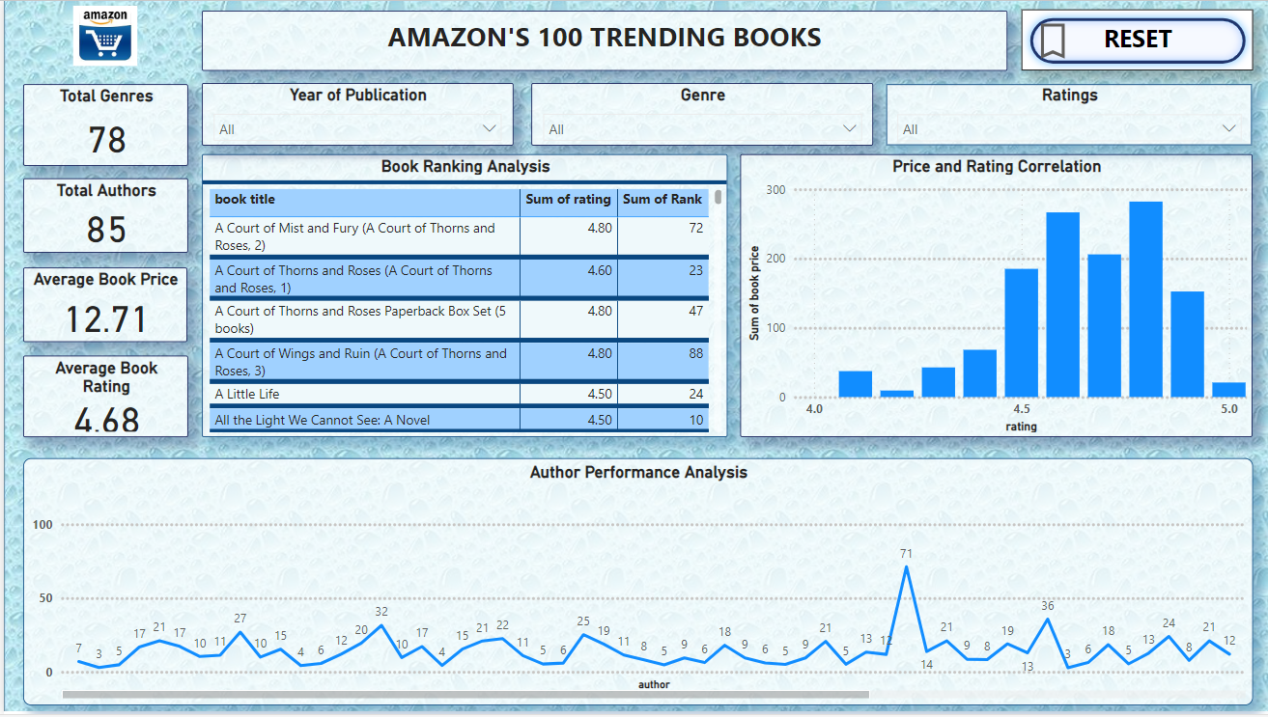

Slide 16
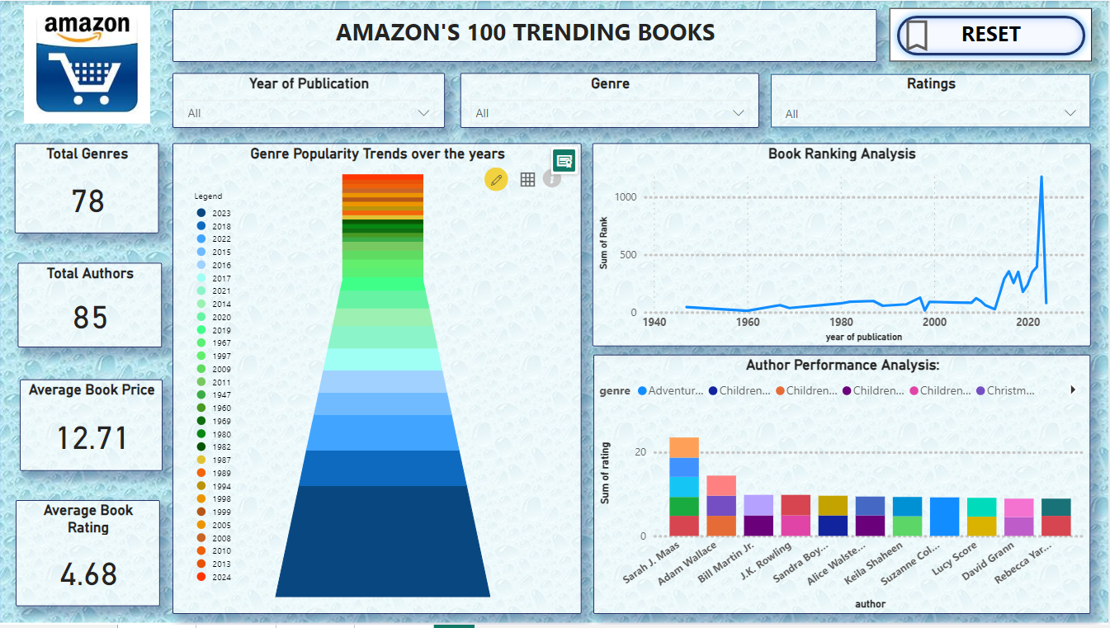

Slide 17
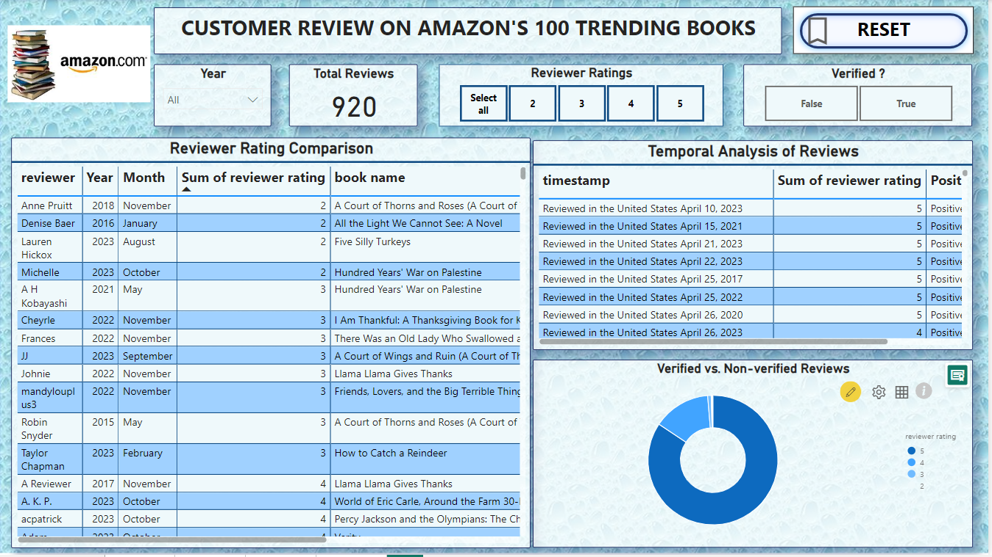

Slide 18
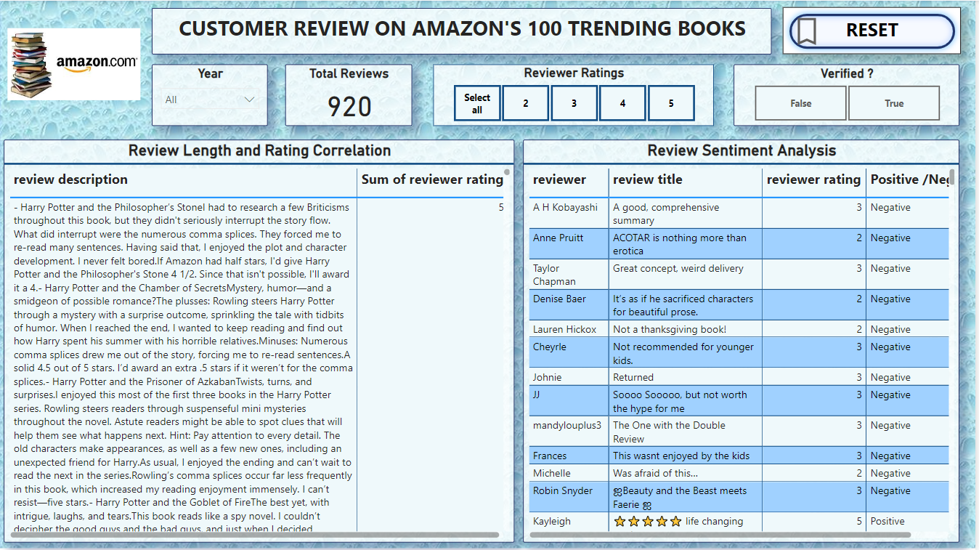

Slide 19
Thank You.

